Slide 1
Load Securement
Photo examples

Slide 2
Every Load is Unique
Imagination creativity and knowledge are important.
Having the proper equipment that is in good repair is the driver’s responsibility.
Proper securement is crucial for your protection and the safety of the general public and the customers’ freight.

Slide 3
Contents
64. Sheet Decking/Steel loads
67. Steel Joist Loads
71. Various
4. Steel Coil
9. Structural Steel
11. Steel I-Beams
13. Tier Tubular pipe
15. Pyramid load Pipe
18. White Tarped line pipe
21. Yellow Jacket Pipe
25. Pipe Spools
28. Plastic Tubulars
31. A/C Rooftop Units
34. Culverts
36. Styrofoam loads
39. Dimensional Lumber
42. Tarping Steel loads
48. Rebar
51. Scrap cars
53. Hay Bales
56. Heavy Equipment
61. Shipping Containers

Slide 4
Steel Coil
Metal corners must be used at every contact point on the coil with the Chains.
Bunks must be arranged so that there is one aligned with each center rail on the trailer and at each edge of the coil or coils.
Hardwood Dunnage must be used.
There should be a minimum of 1 chain positioned at the lower front edge of the coil.
2 Chains at the lower rear and 1 over the center top of the coil.
See the picture example provided.

Slide 5
Steel Coil

Slide 6
Steel Coil
<- Rear
Front ->

Slide 7
Steel Coil
←Rear
Front ->

Slide 8
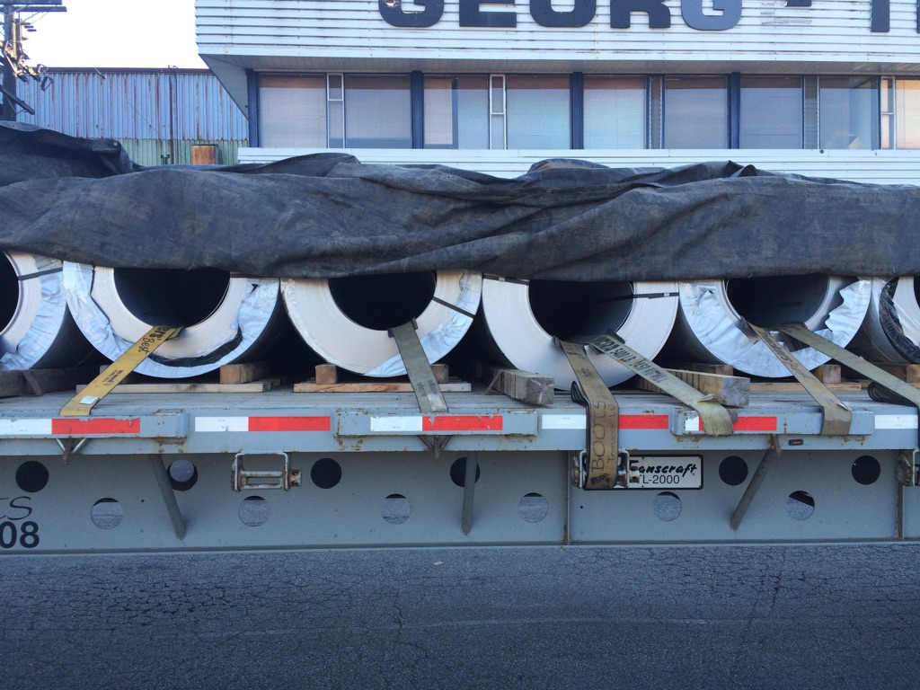
Lightweight Coil
Straps can be used with edge protection when the coil is small and sitting in bunks as shown.
The forwardmost and rearmost coils should still be chained.
A 4” X 4” dunnage board should be chained to the deck in front and in back of the load.

Slide 9
Structural Steel
Structural Steel comes in almost an infinite variety of shapes and sizes. Securement takes care and creativity. Edge protection is important to ensure the integrity of the securement. Be sure to check for down pressure on all items on the load.
If the load is stacked with dunnage between layers each layer must be secured separately to prevent shifting during transport.
If the load is wider or longer than the trailer then flags and lights will be required, and depending on width, over-dimensional signs may also be needed.
If in doubt call Driver services.

Slide 10
Structural Steel

Slide 11
Steel I-beams
Generally straight forward but the example shown is not properly loaded due to the dunnage. Can you spot the problem?
Corners/Strap protectors must be used on sharp edges. Adding a chain in the first 5 feet of the load is recommended
Ensure you look in the I Beams for any loose debris including loose wood and metal banding. Remove before transport as this can cause an incident as well as an out of service during a dot inspection

Slide 12
Steel I-beam

Slide 13
Tiered loaded Steel Tubulars
Dunnage must be aligned top to bottom with wood or plastic wedges securely nailed, best practice is top and bottom as show in slide.
Each tier with the exception of the very bottom must have a minimum of 2 per tier as far apart as possible.
The top layer must have 2 straps in the first 10 feet and no more than and a minimum of 1 strap per every 10’ after that
Planning is important so that these complicated loads can be both legal and secure.

Slide 14
Steel Tubulars Tiered load

Slide 15
Pyramid loaded steel tubulars
This has long been the standard for steel casing, any pipe with “collars” and threaded ends. It relies on short steel pins (4 per side) on full length loads or 2 per side on short pipe to secure the lowest layer.
Each subsequent layer is 1 less pipe, eventually forming a “pyramid”. If the top layer does not have enough pipe to complete the pyramid ask that the top pieces be loaded on separate dunnage.
These loads require 2 belly wraps, 1 on the first 10’ and 1 on the rear 10’ as well as down pressure straps. Attention must be given when approaching the load to ensure no collars in the stack are beginning to bulge out. If there is then have a loader fix the load before getting near it.
Once all straps are tight the driver should walk around the trailer and ensure all pipe pins and dunnage is tight without any movement.
Multiple short stacks are shown in the example without collars.

Slide 16
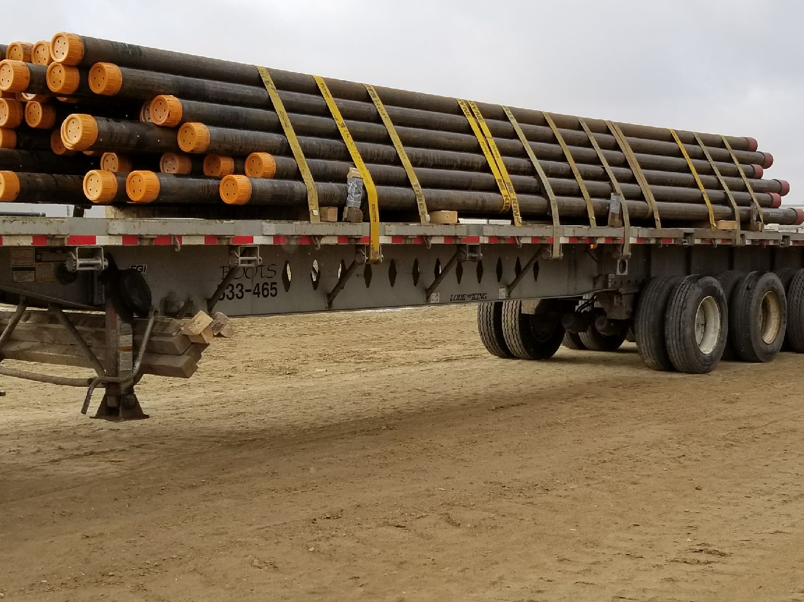
Belly wraps should be further apart.
About 10’ in from each end.

Slide 17
Steel Tubular Pyramid Load

Slide 18
Tarped Line Pipe
We use white “Onion Skin” tarps that are light weight but fragile to cover these loads. The best practice is to put two down pressure straps 1 front and 1 back but leaving the outside most winches available. Then 2 belly wraps 1/3 of the way toward the inside of the trailer length from each end.
Install the tarp and use as many straps as possible over top of the load to reduce the need for bungee cords which will prevent flapping and tearing of the tarp

Slide 19
White Tarped Pipe Load
More straps over the top of the tarp is required to ensure tarp is tight. This will reduce flapping which will damage tarp

Slide 20
White Tarped Pipe Load

Slide 21
Yellow Jacket Pipe
This refers to coated steel pipe. The coating is sometimes other colors like green. It requires special set up and handling. In all cases the dunnage must have padding over the wood either carpet or old strapping to protect the integrity of the coating.
The front and rearmost dunnage must be raised by use of a 2” by 6” board to level the trailer deck which typically has a curve to it.
Extra care must be used in strapping down as the pipe is extremely slippery. Using every available strap winch and at least 2 belly wrap, but more is preferable.
Best Practice is to use a ratchet strap around the end of the load to keep movement of the pipe as a whole instead of it all individually.

Slide 22
Yellow Jacket Coated Pipe

Slide 23
Yellow jacket pipe

Slide 24
Don’t Tie too loosely!

Slide 25
Pipe Spools
Pipe spools are secured through the center of the spool and either chains or straps can be used to secure. They should be at 30-45 degrees from and back of center with a minimum of 2 tie downs depending on the weight.
Use a 4” X 4” piece of Dunnage chained or strapped to the deck in front of the first spool and behind the last to prevent movement.

Slide 26
Plastic coiled pipe on spools

Slide 27
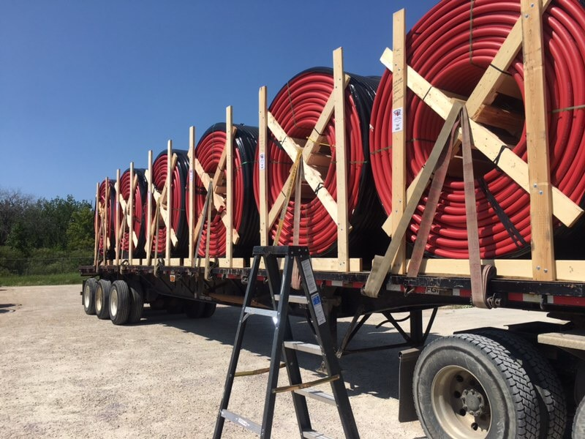

Slide 28
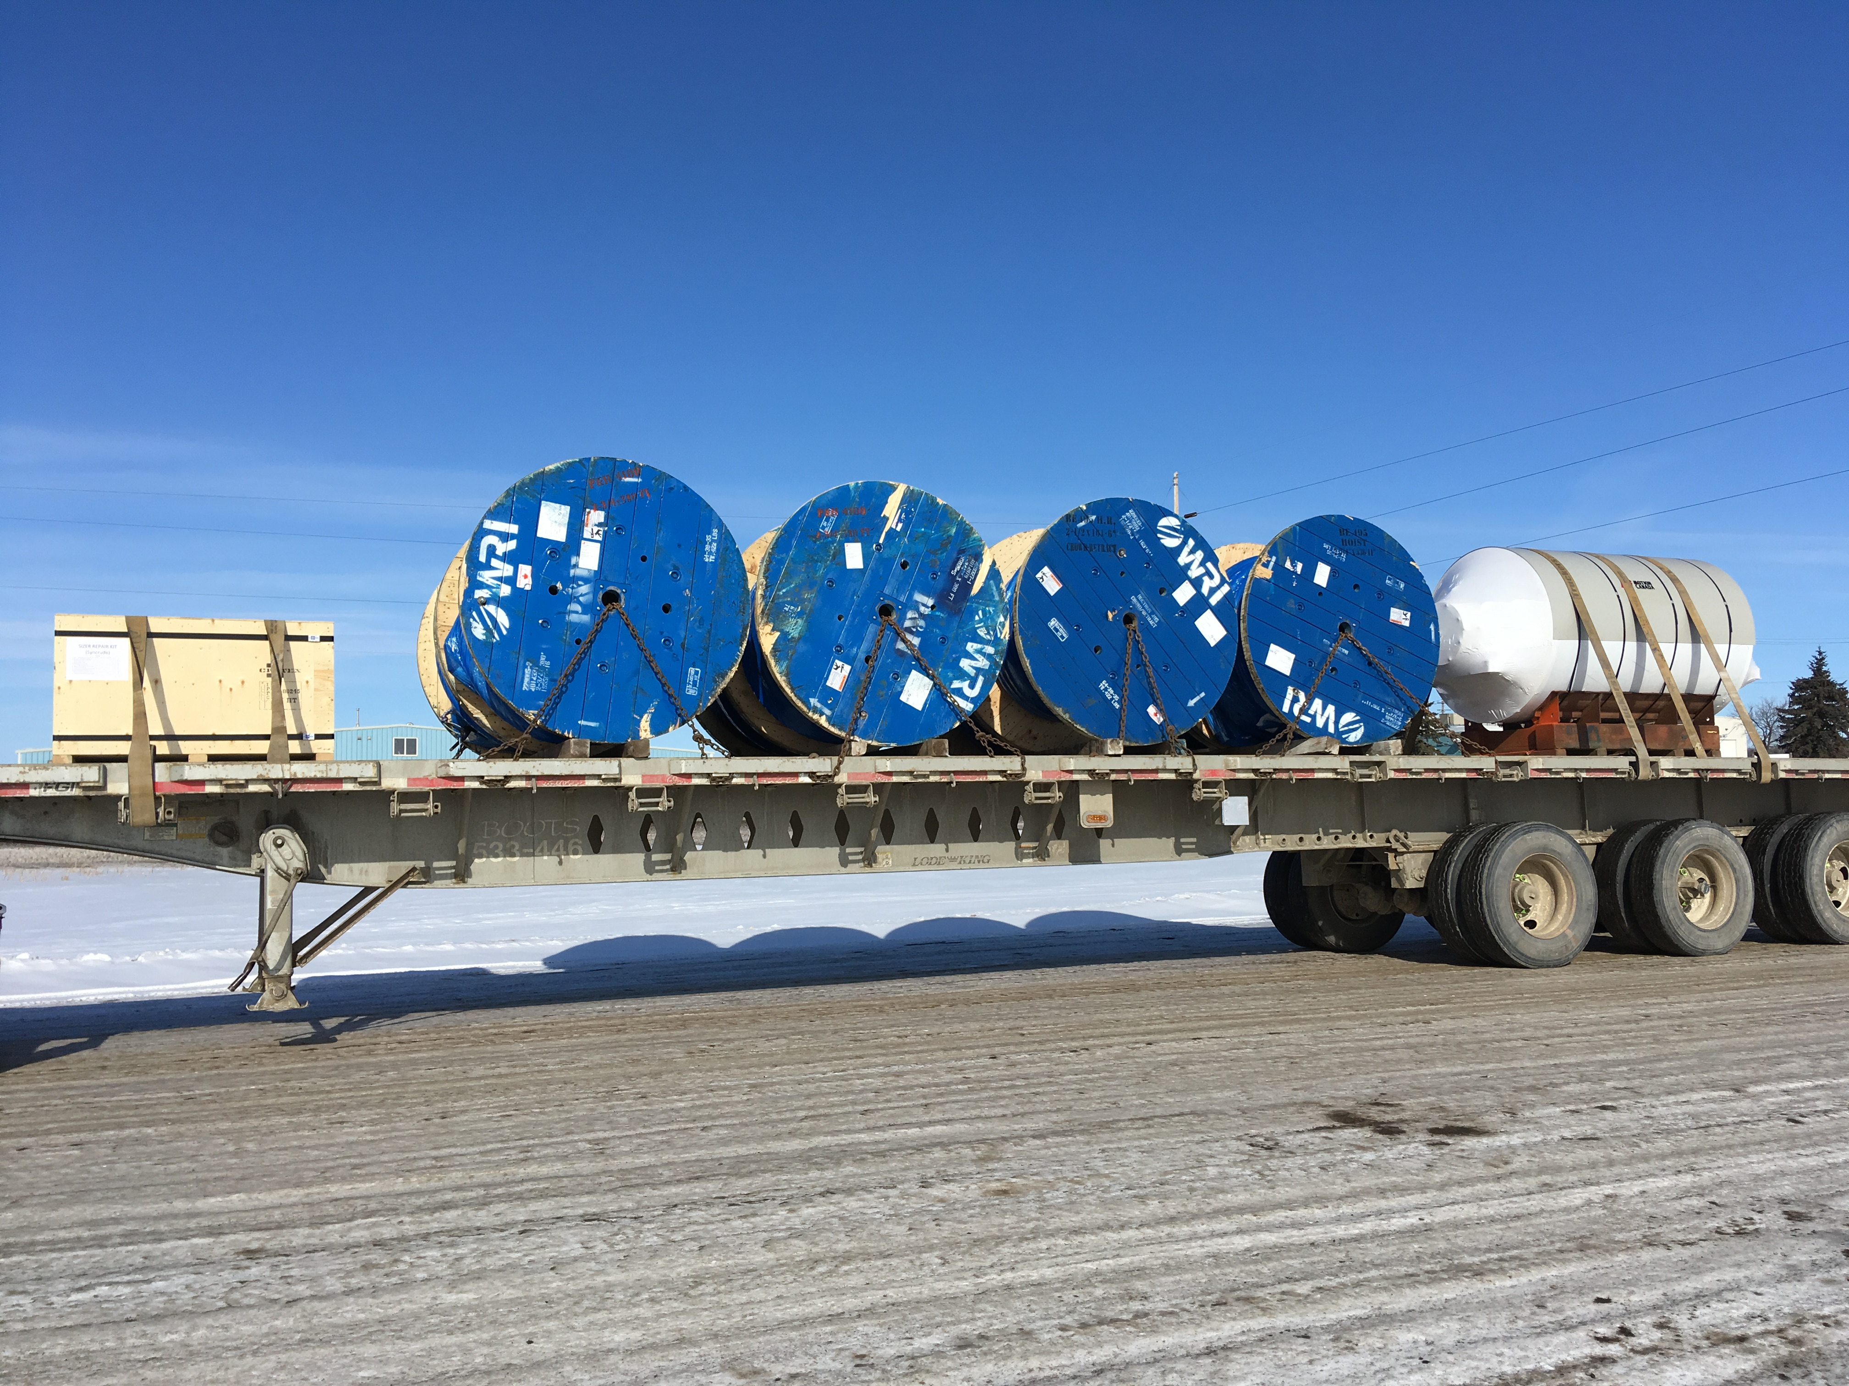

Slide 29
Plastic Tubulars
Most plastic pipe is bundled and has wood “crating” with steel straps to hold the bundles together. It should be strapped with a minimum of two straps per bundle near each end if shorter than 12 feet.
If the “crating” is damaged make the shipper and receiver aware immediately.
More Straps if longer to comply with strapping standards ( straps no further than 8 feet apart, minimum 2 in the first 10 feet and no less than 8 on a 53’ load).

Slide 30
Plastic Pipe
The pictured load has not been tied down yet.
You can see the banding and “Crating”.
It has 2 tiers and as such should be strapped individually.
The driver should have throw straps over the lower bundle before the loader put the top tier on.

Slide 31
Rooftop A/C Units
Special Care must be taken with A/C units to prevent damage and Movement during transport. The units are fragile and over tight straps will crush them.
Straps should be on the outermost edges of the square units, never in the center! The strap edge should overhang the edge by just a couple of millimetres.
To prevent movement a 4” X 4” can be strapped or chained behind, beside or in front of the unit across the deck.
The Larger units that have a “V” shaped section should be strapped as if the square part was a separate unit and a strap can go through lower frame across the bottom of the “V” section. If not sure consult with your safety supervisor prior to securing the units.
Stacked units must be perfectly aligned and the securement is the same as for the above treating the stack as a single unit.

Slide 32
Roof Top HVAC units

Slide 33
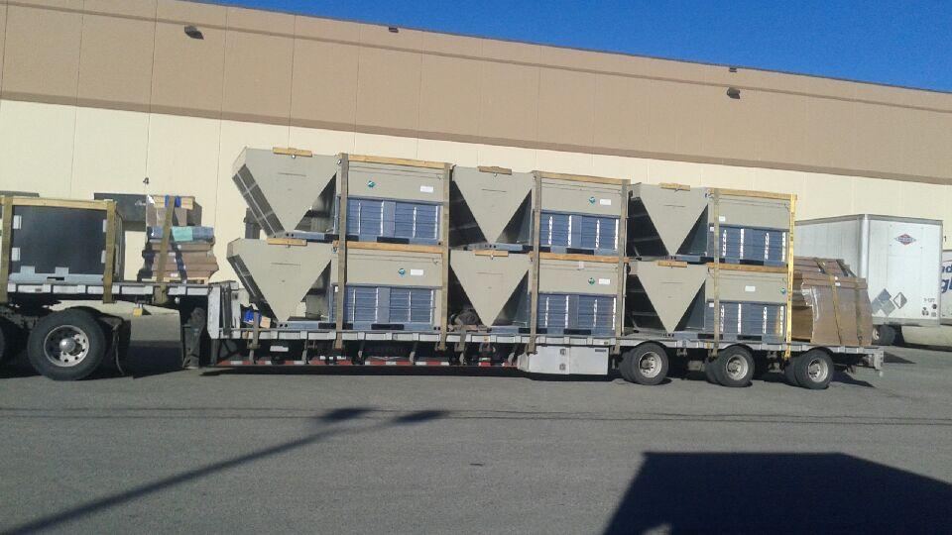

Slide 34
Culverts
Culverts are relatively light and strapping is similar to any other tubular product.
Short sections shipped upright will need edge protection for the straps but longer sections usually do not. Be sure to check that smaller diameter units have not been put inside larger ones without being strapped / banded together.
Normal rules apply for tie down numbers.

Slide 35
Culverts

Slide 36
Styrofoam Sheets
Styrofoam sheet loads are delicate and easy to damage. They are very light and usually in 8 to 10 foot long bundles. 2 straps minimum per bundle.
Hard edge protection MUST be used between the strap and the foam and care used when tightening the straps.
A nose tarp is to be used on every load secured with rope provided by the shipper if you do not have.
Straps are to have a forward facing “half-Twist” to prevent the straps from vibrating and potentially tearing the plastic wrapping on the foam.
On some thin sheet loads the rear will need to be cross strapped with all contact points with the foam edge protected. See example. This prevents the load “walking out” the rear during transport.
Remember these loads are extremely light weight and the straps have to be just tight enough to prevent movement but not damage the freight.

Slide 37
Styrofoam sheets

Slide 38
Styrofoam Sheets

Slide 39
Dimensional Lumber
Lumber loads are fairly straight forward, however they are heavy and require many straps.
Loads often have multiple tiers with different length bundles and it is important to make sure that downforce at each end of every bundle is maintained.
A single top tier is often added as in the photo example and must comply with the minimum number of straps. Special attention is required with placement of the lower bundles so that there are sufficient for the top tier.
If the lumber is more than 10” past the rear of the trailer the outer corners must be flagged.

Slide 40
Dimensional Lumber

Slide 41
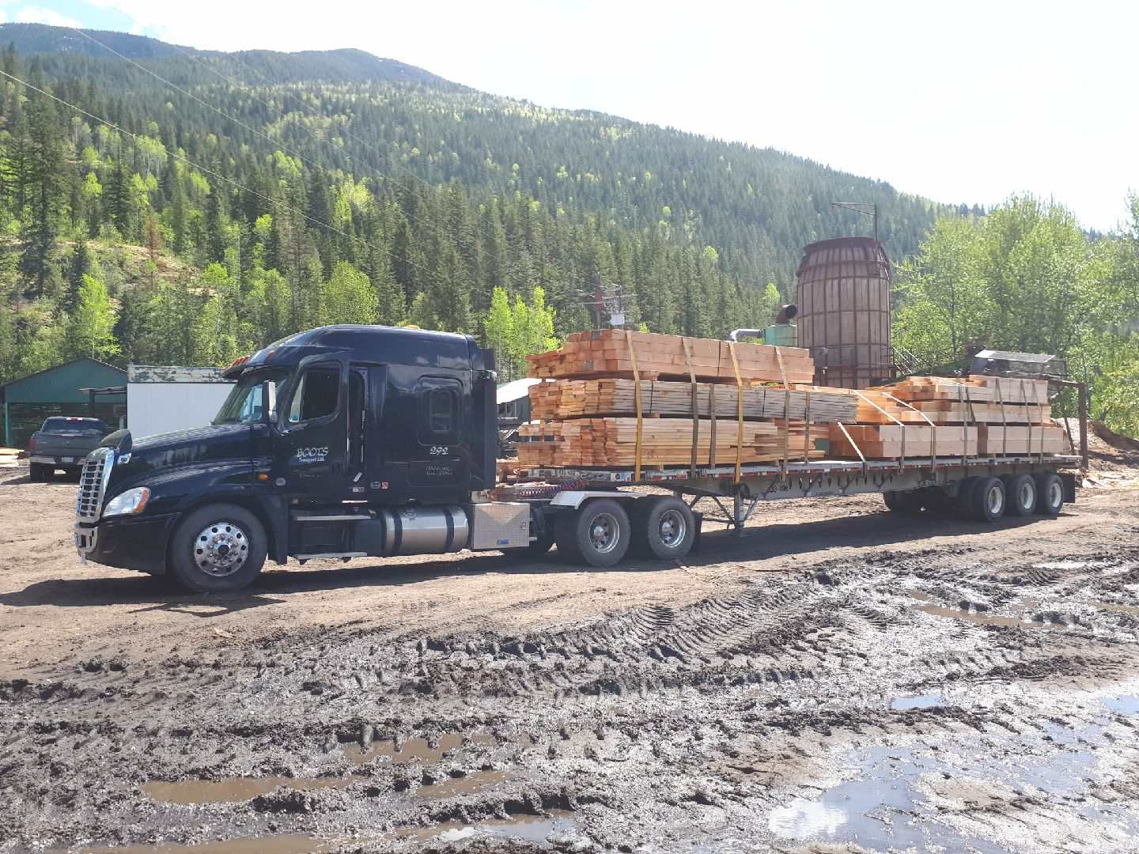

Slide 42
Tarping Steel loads
If the loads are picked up in Calgary or Edmonton / Nisku you are required to come to the Boots yards to use the tarping machine.
Loads must be securely strapped prior to tarping
If you are in any other city you must use extreme care when rolling the tarps out over steel loads. Be aware of uneven surfaces and edges of the load to prevent falls.
Loads sometimes have one or more pieces that will stick out beyond the extent of the tarp.
Tarp loads should be un-tarped once they have been checked in by the receiver and not before. When you tarp a load mark it on your run sheet.
Flags and lights (if moving during darkness) must be used on any load wider or longer than the trailer. Inform dispatch to make sure you have the necessary permits in place.

Slide 43
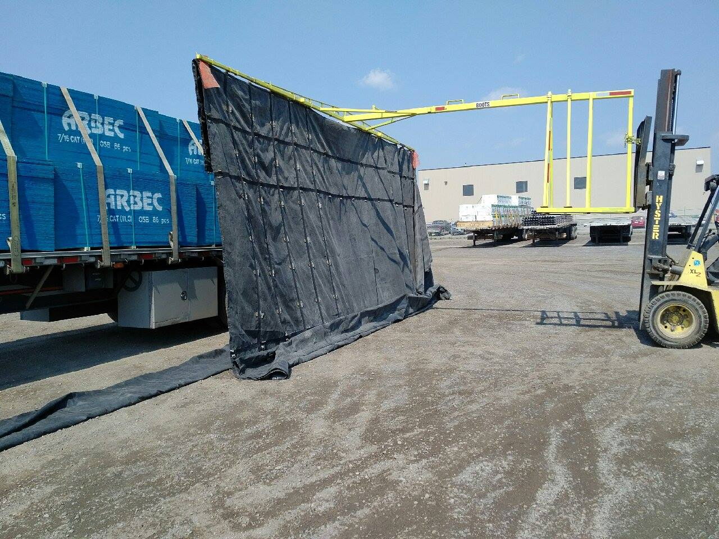
Calgary Yard Tarping Station In action.

Slide 44
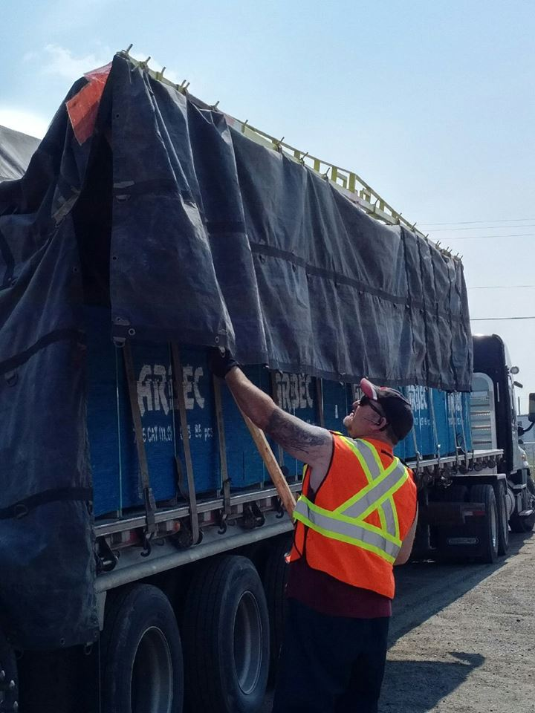
Using the pole to unhook the eyelets from the tarp machine boom on the far side of the trailer.
Driver never has to leave the ground.
The safest way to put a tarp on a load.

Slide 45
Tarped Structural Steel Black-tarped

Slide 46
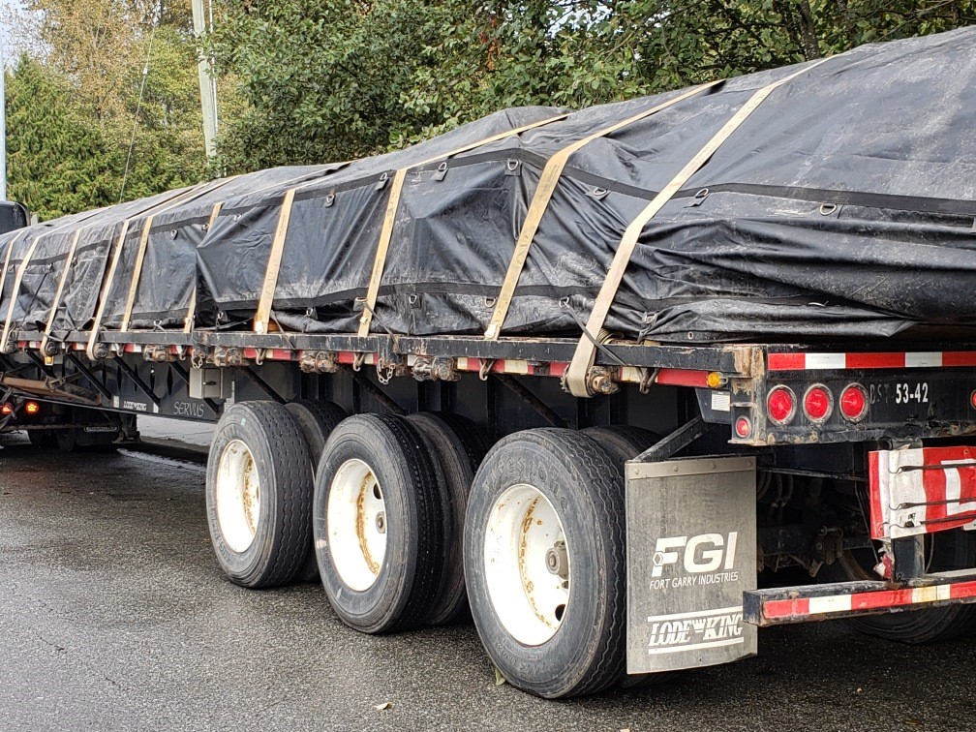

Slide 47
Rebar Loads
Rebar can Be a real challenge and can require a lot of straps to ensure that all the bundles are secure.
Some very small item are in white nylon bags that one strap is sufficient on.
Take special care when walking around the load to avoid ontact with sharp ends.
Unsure that all protrusions are flagged.
Double and triple check that all bundles some very small are secured for transport.

Slide 48
Rebar

Slide 49
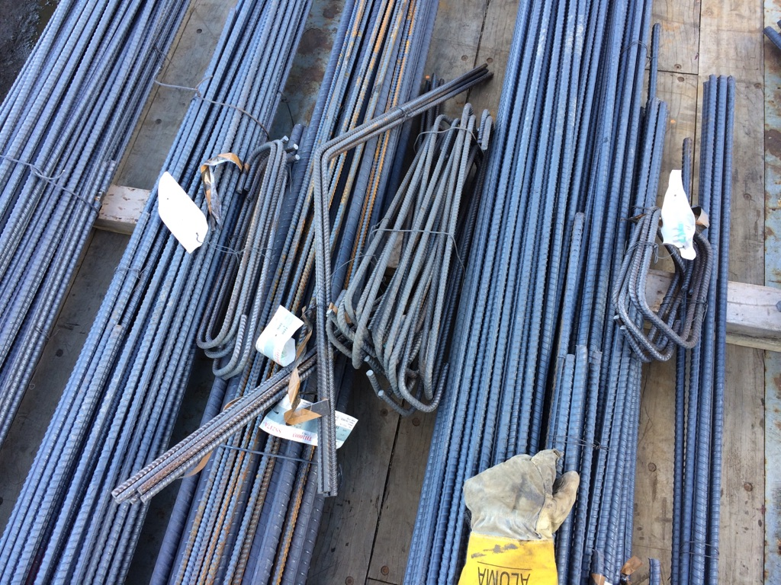
Rebar example:
Note how small some bundles can be.
Strap placement is important.
Small bundles can be moved if needed so that they can be tied down securely.
Belly wrap to draw any separated bundles together.

Slide 50
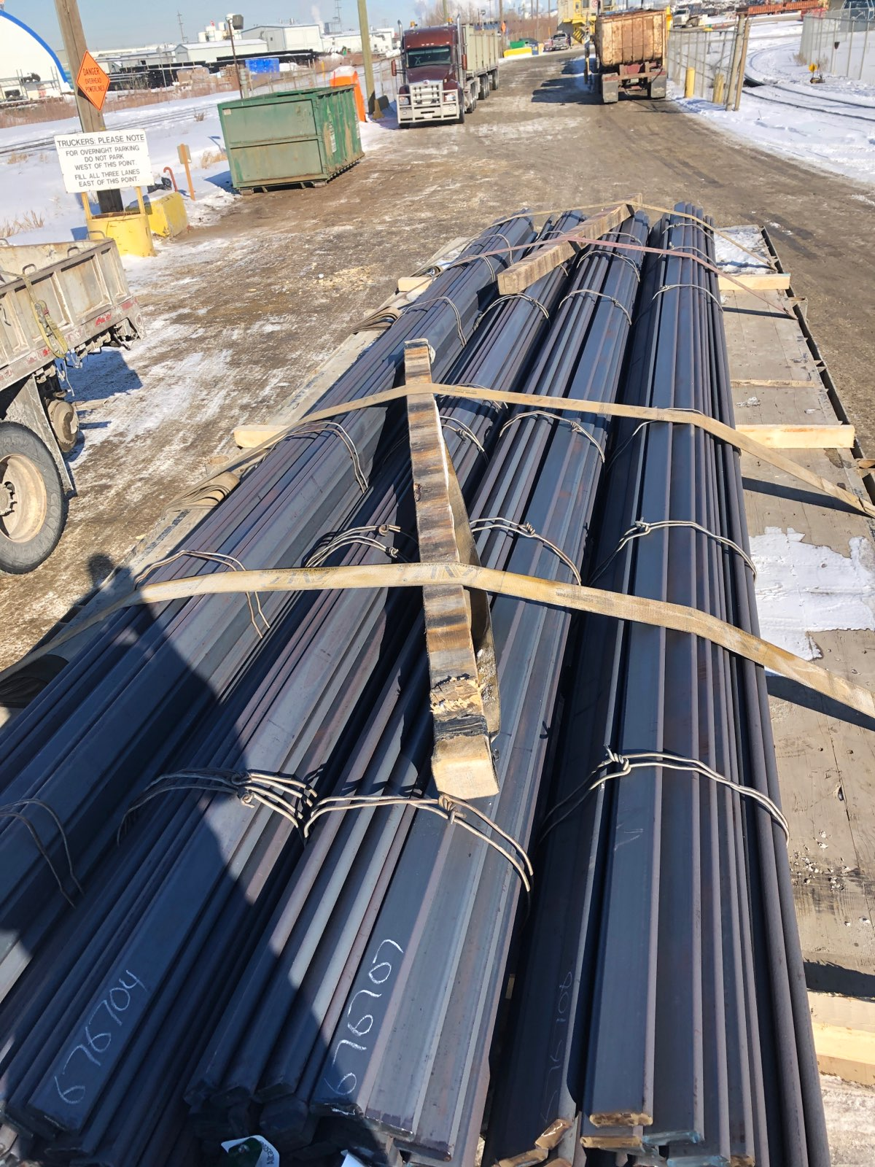
FLAT BAR
IF THE MIDDLE BUNDLES ARE LOWER THAN THE OUTER BUNDELS THE STRAP WILL “FLOAT OVER” THE MIDDLE BUNDLES. 2 4X4’S MUST BE ADDED UNDER THE STRAPS ON THE MIDDLE BUNDLES TO ENSURE DOWNFORCE ON ALL BUNDLES.

Slide 51
Scrap Cars
We on Occasion haul scrap crushed cars. They must be secured with Steel Cables provided by the shipper. Chains can be used as well if needed.
Plastic netting is supplied by the shipper and must be used to cover the entire load to prevent small pieces from flying off during transport.
Cables and netting is left at the delivery point if supplied by the shippers.

Slide 52
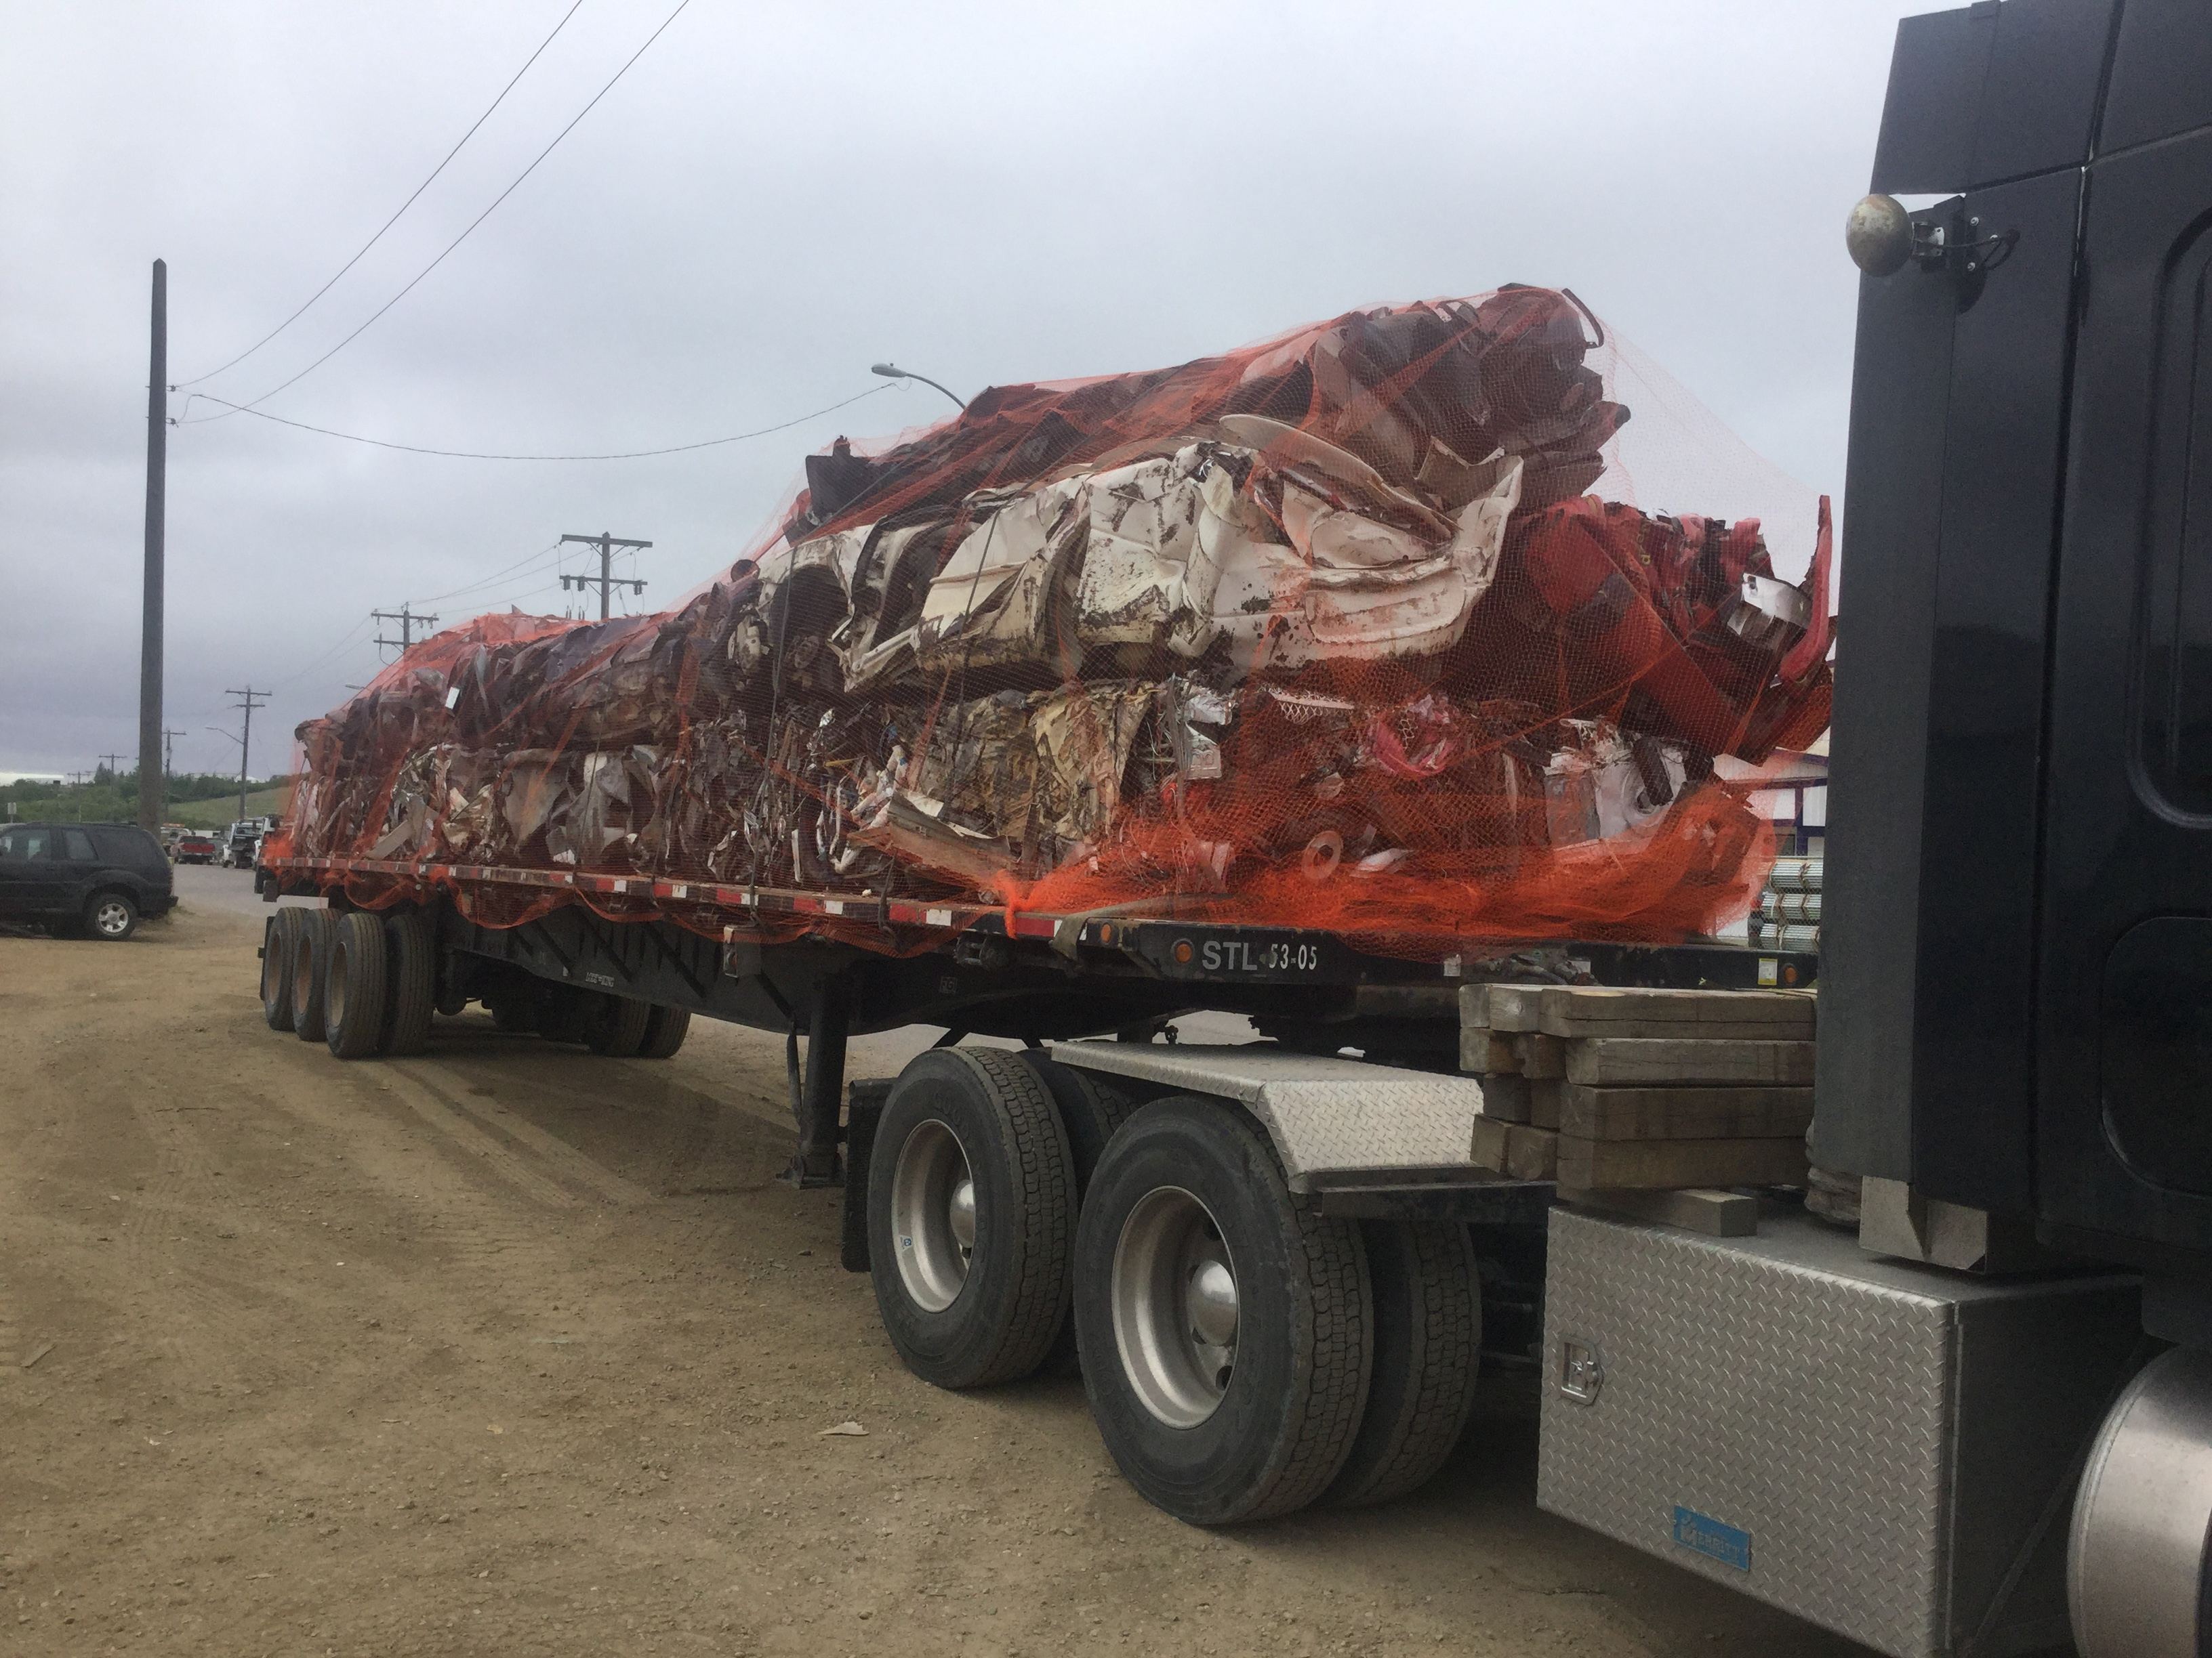
Note the cables and orange netting over the load.
The excess netting secured with a strap front and back.

Slide 53
Hay Bales
Hay bales are rarely moved but special caution should be used during loading and tying down. They are heavy and can roll or tip and crush you. Be sure to be parked on level ground during loading and off loading.
Sometimes pins or chained down dunnage must be used on the front or back with round bales to prevent shifting. You cannot damage the product due to its nature.
Cross strapping front and rear is best practice.
Be sure to know your overall dimensions and use flags and Over-dimensional signs when required.
Know your height for bridge clearances!

Slide 54
Hay Bales

Slide 55
Hay Bales

Slide 56
Heavy Equipment securement
Securing wheeled or tracked equipment should always include cross chaining from the front and rear of the units. Securement points are usually obvious but if in doubt ask the shipper.
In the case of a deck or trailer the rear axle and landing gear are the tie down points.
Additional accessories like a bucket can be strapped with 2 straps or chains per unit.
Smaller single axle units should have a 4” X 4” strapped on to the deck infront and behind the wheels to prevent movement in addition to the other securement.
NOTE: You must use ratchet boomers for any equipment securement. Some customers do not allow “snap boomers” to be used on their properties.

Slide 57
Equipment

Slide 58
Heavy Equipment

Slide 59
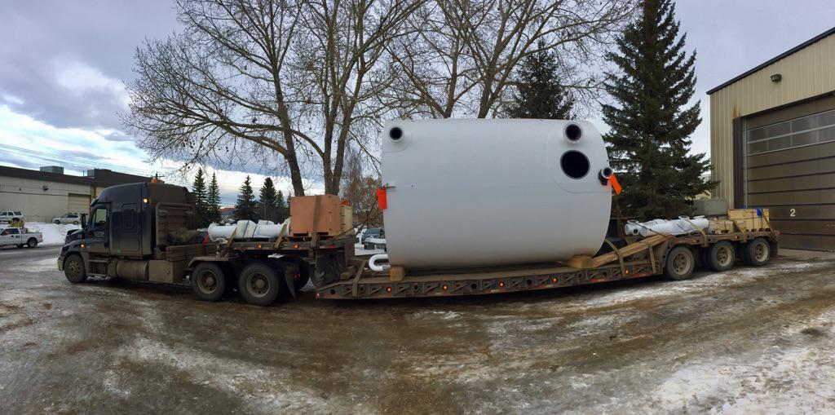

Slide 60
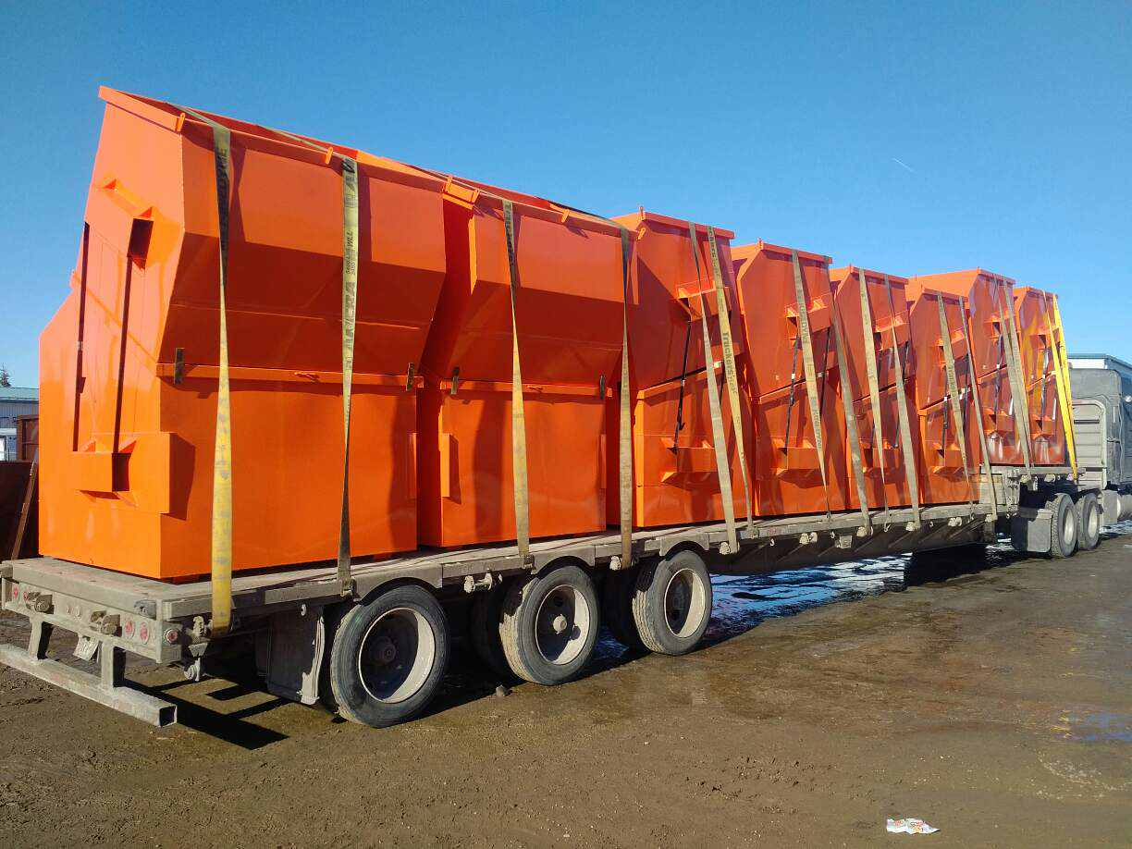

Slide 61
Shipping Containers
When securing shipping containers on a flat deck trailer you must cross-chain both front and rear of the container as shown in the example. The bottom edges of the container / s must be in contact with the deck.
Additional straps can be used depending on the weight of the container. It is also better optics for the public during transport that may not notice the chains.
Know your Height for shipping!

Slide 62
Shipping Containers

Slide 63
Measure
Make sure that you know your overall dimensions.
Measure height of freight and deck height
Special Routing and permits could be required.
Think about Tunnels and bridge decks / under passes.

Slide 64
Steel Decking/ Steel sheet loads
During Winter months loads of Canam Steel are wrapped with plastic sheeting.
You must also tarp over it with the white tarp to ensure it remains clean and salt free.
Strapping is done over top of the white tarp.
See examples on next 2 slides.

Slide 65
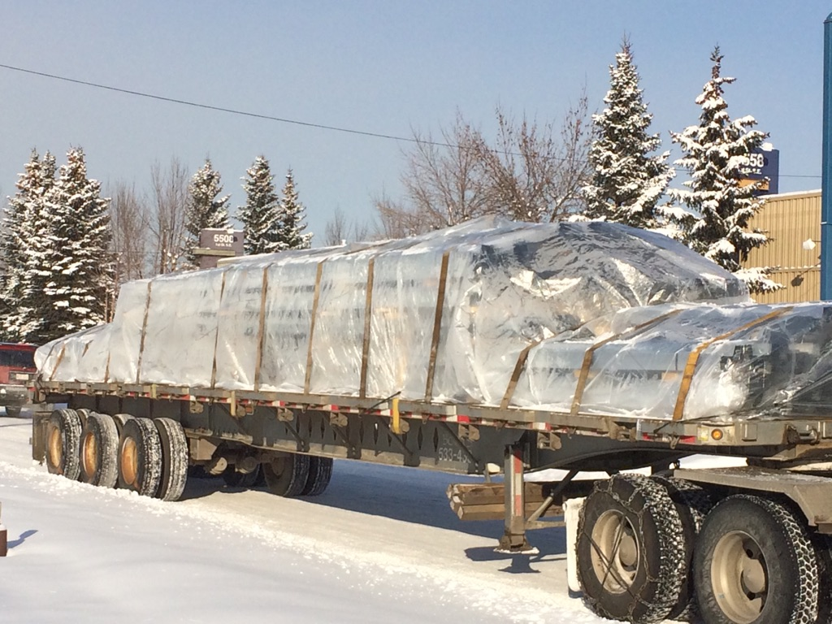

Slide 66
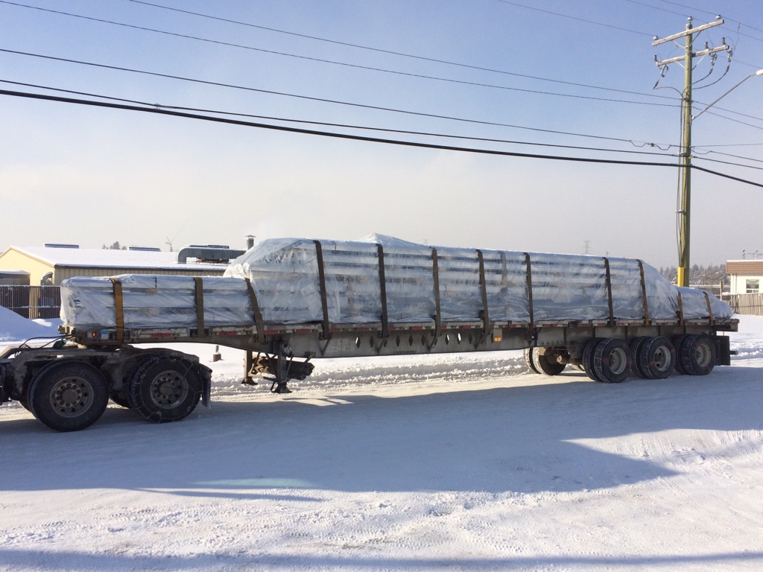

Slide 67
Steel Joist loads
Steel Joists are usually multi layer loads and they must be treated as two separate loads top and bottom with each secured on its own.
The same rules apply as with all strap loads for spacing and numbers.
Edge protectors must be used.
Cross chain the front and back of the load from the top most corners.

Slide 68
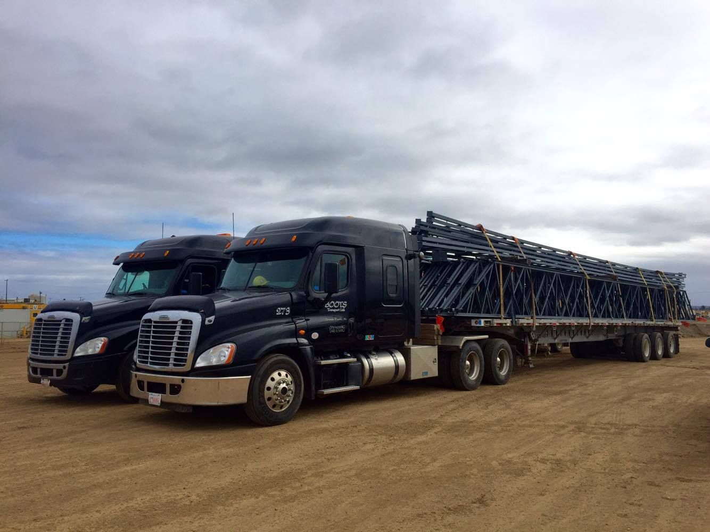

Slide 69
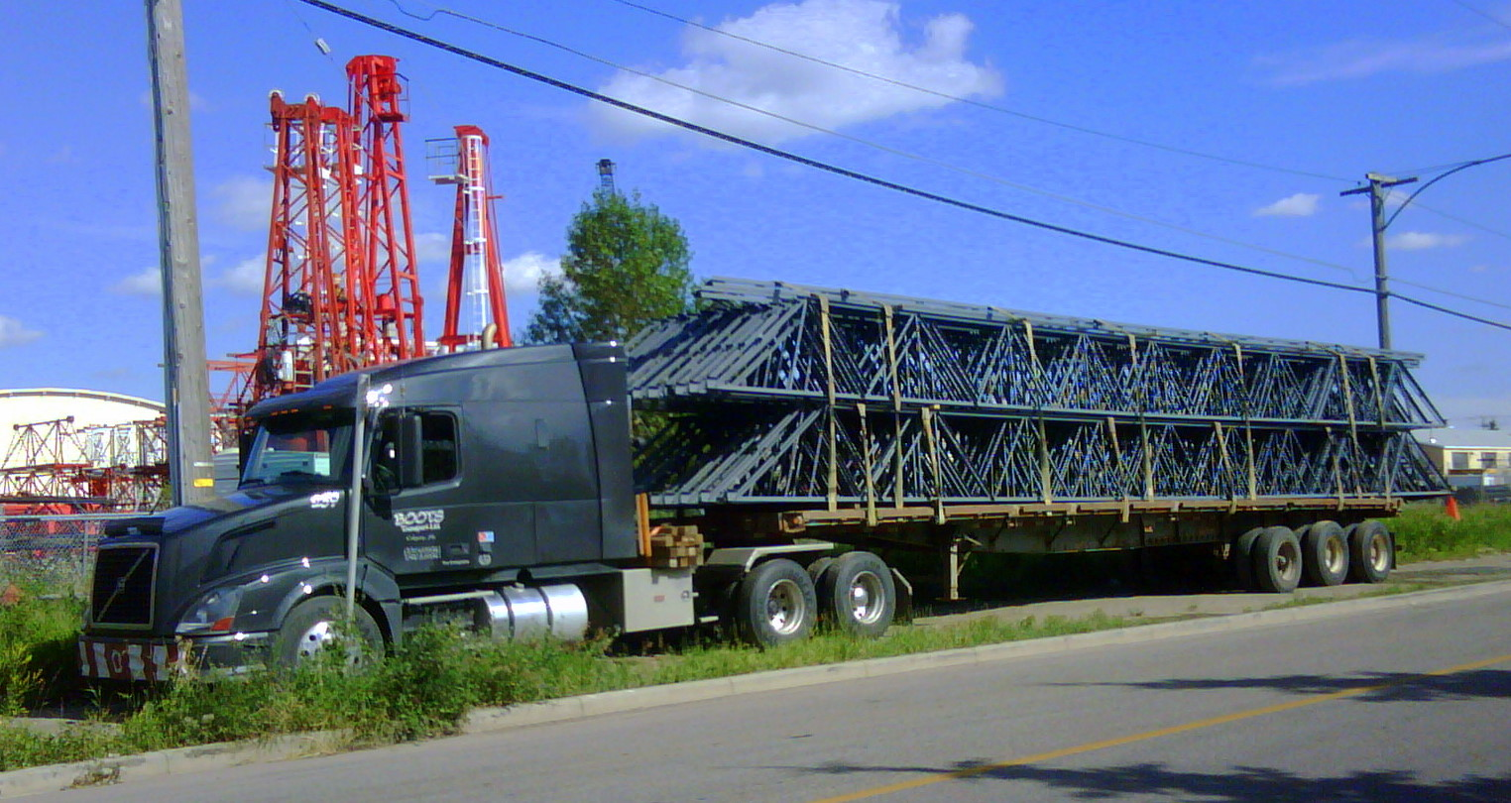

Slide 70
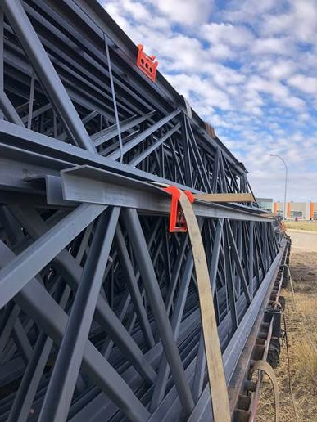
Don’t overtighten
Straps and or Chains should secure but not damage the freight.
This strap should have gone between the two channels rather than over the outer edge.
Note: the load is not complete.

Slide 71
Various Loads
We do a huge Variety of loads as Flat decks are very flexible in what they can haul.
If it is something not covered call your safety Supervisor to consult on the best way to secure the load.
There are experienced support staff that are available to help so make use of them.
Take pictures and send them in. We have the technology so use it to your advantage.
Remember: Safety is your responsibility!

Slide 72
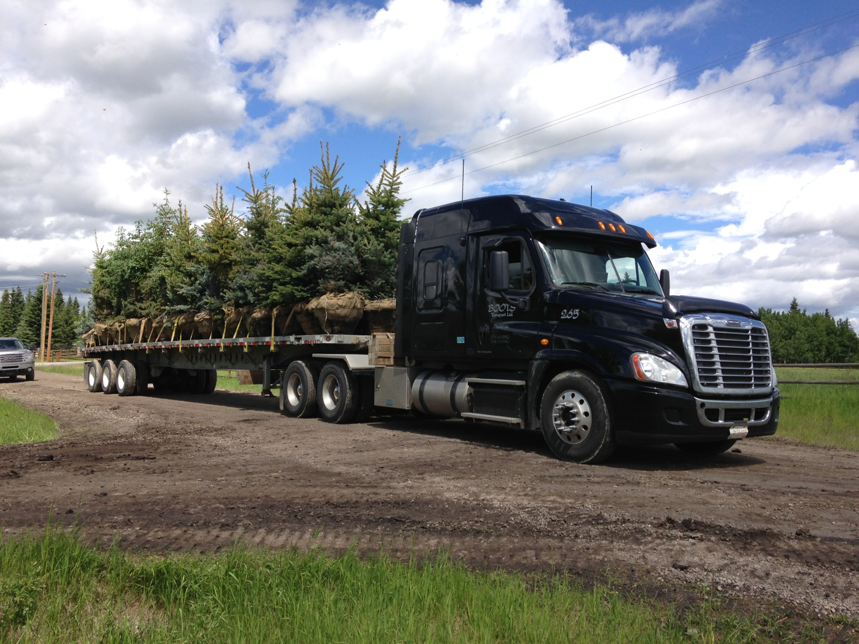
The only way to secure a tree load is with a strap across the root bundle in front and at the rear of the tree trunks.
Two straps per line of trees.
Careful placement on the deck is important so that the straps will align.

Slide 73
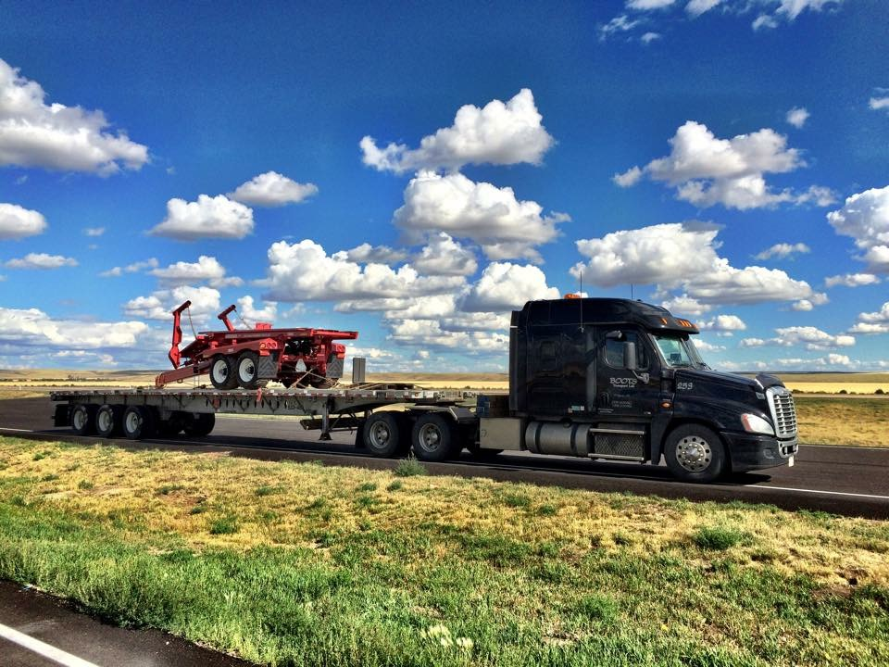
The Equipment was cross-chained front and rear from the axles.
Additional strap on the hitch.
Accessories were strapped separately at the front on a pallet.

Slide 74
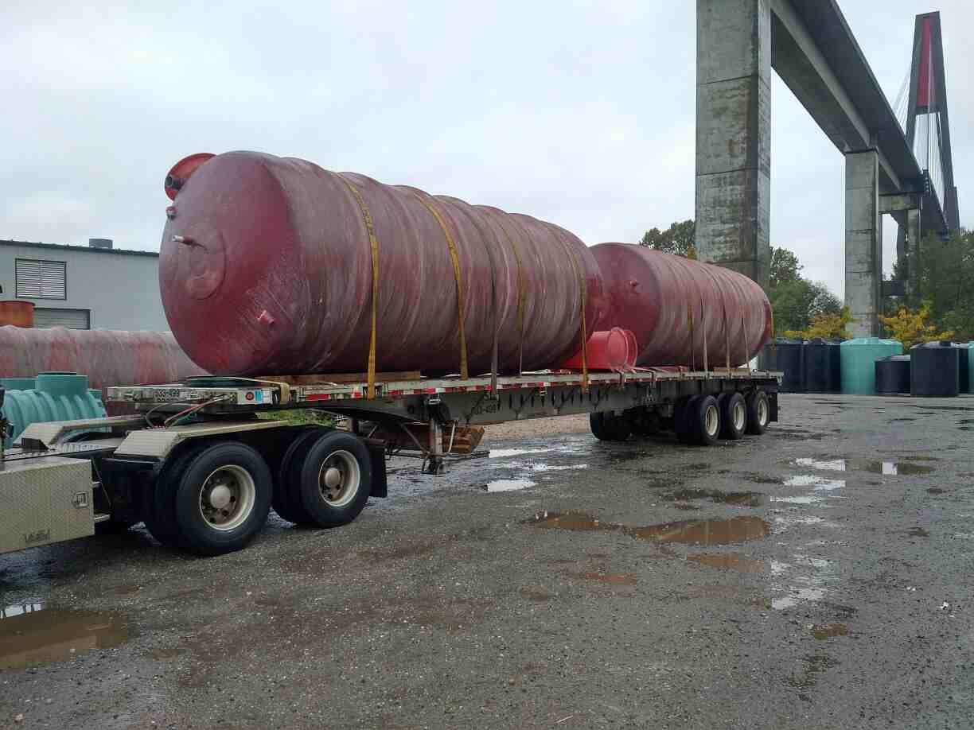
Large round tanks although straight forward to strap must have dunnage secured under them to prevent rolling side to side.
The driver strapped and nailed the dunnage to the deck front and rear of each unit to ensure that the dunnage did not come loose and present a hazard during transport.
Note the specific alignment of the tanks so that they were not over-height due to the collars.

Slide 75
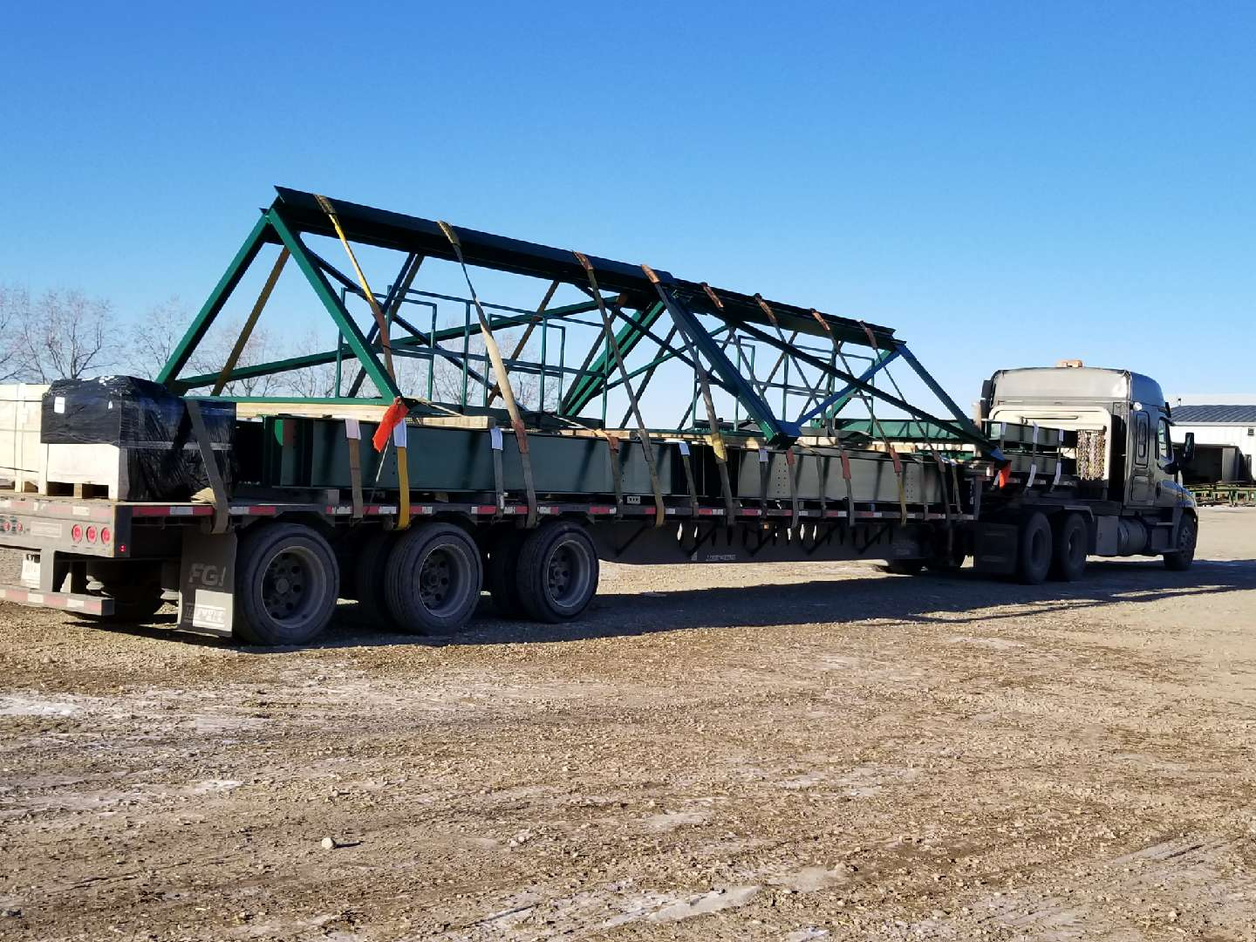
The mixed load shown had a heavy frame on top of large metal I-Beams.
With the dunnage separating the two heavy loads, they had to be treated a separate loads and extra securement with chains at each end to prevent sliding during transport. Smooth painted steel is a slippery surface and this must be considered when securing.
Additional frames were inside that were secured at the bottom so that the lightweight rails were not damaged.

Slide 76
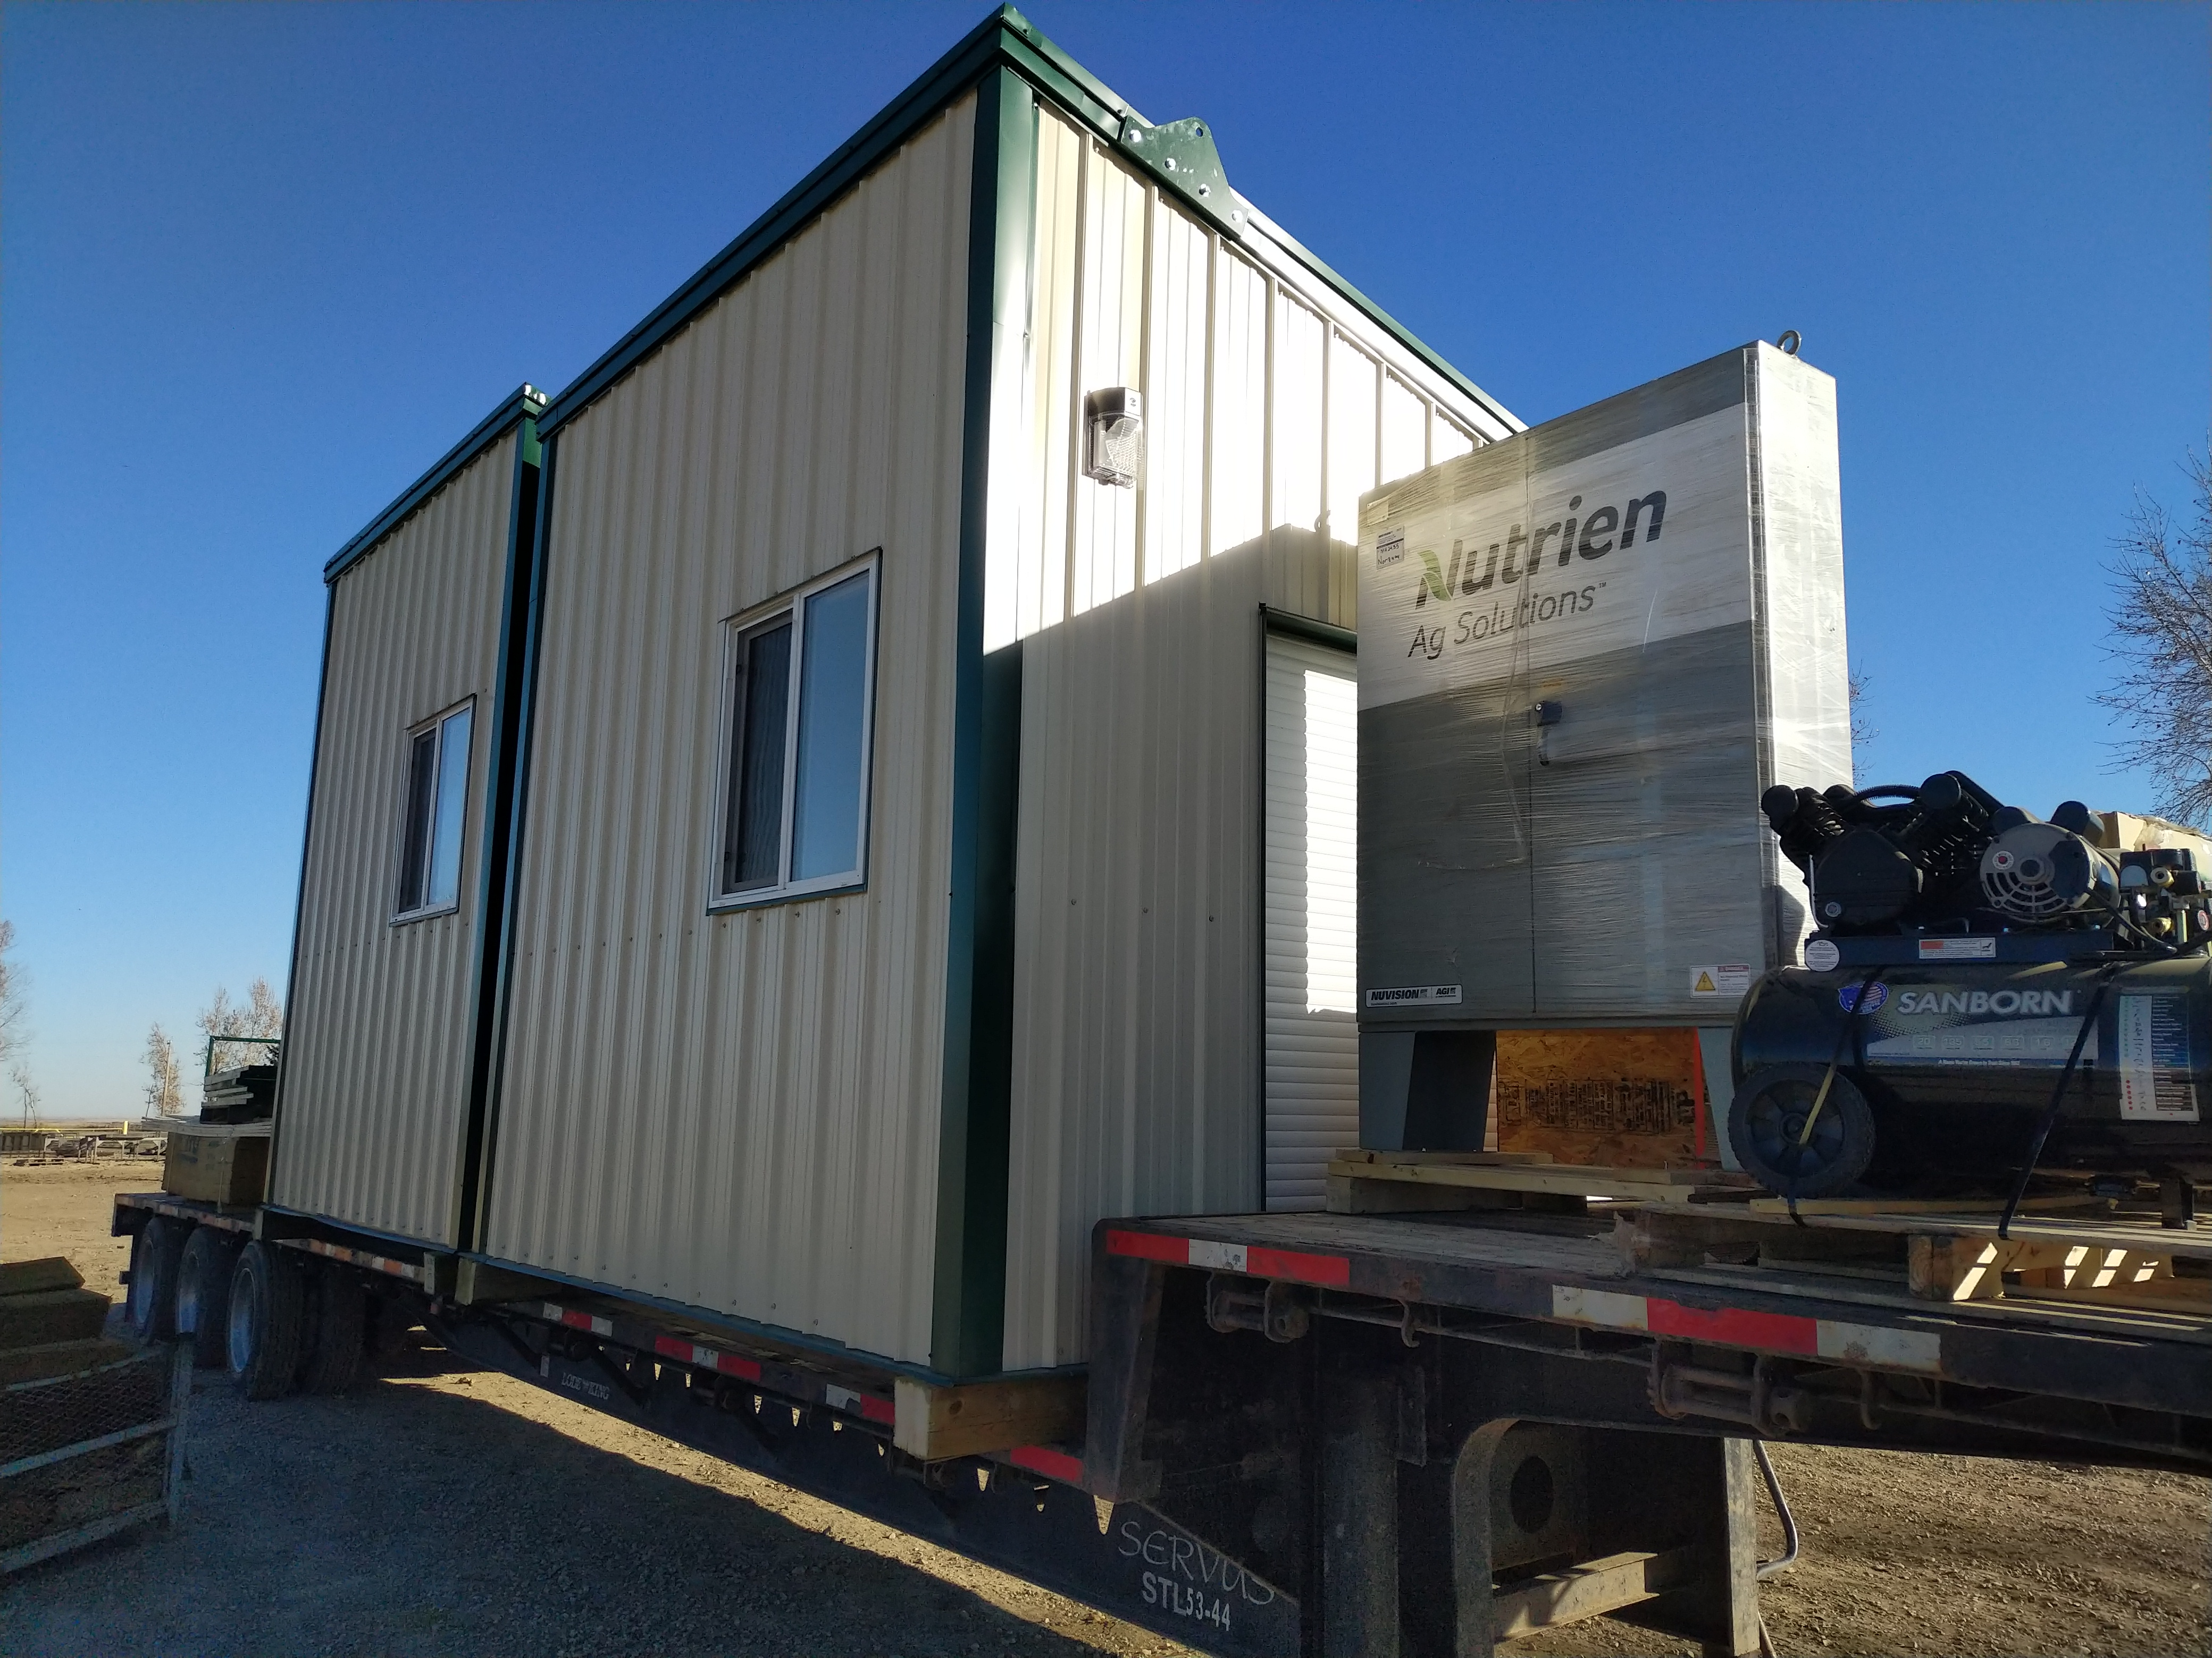
When Strapping buildings as shown Straps should have edge protectors and avoid going over windows.
Mixed loads like the one shown take careful planning for strap placement and should always be measured at the highest point for routing consideration as well as signage and flag placement.

Slide 77
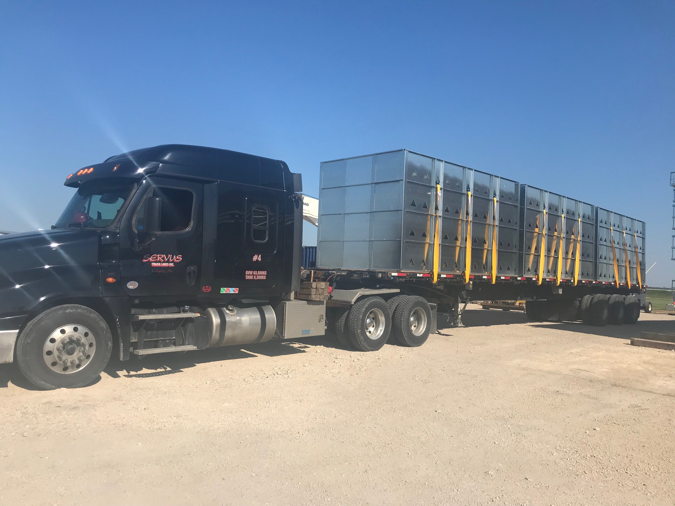
Special strapping requirements as shown required the use of “C” or “J” hook straps as per the customer, who supplied them in this instance.

Slide 78
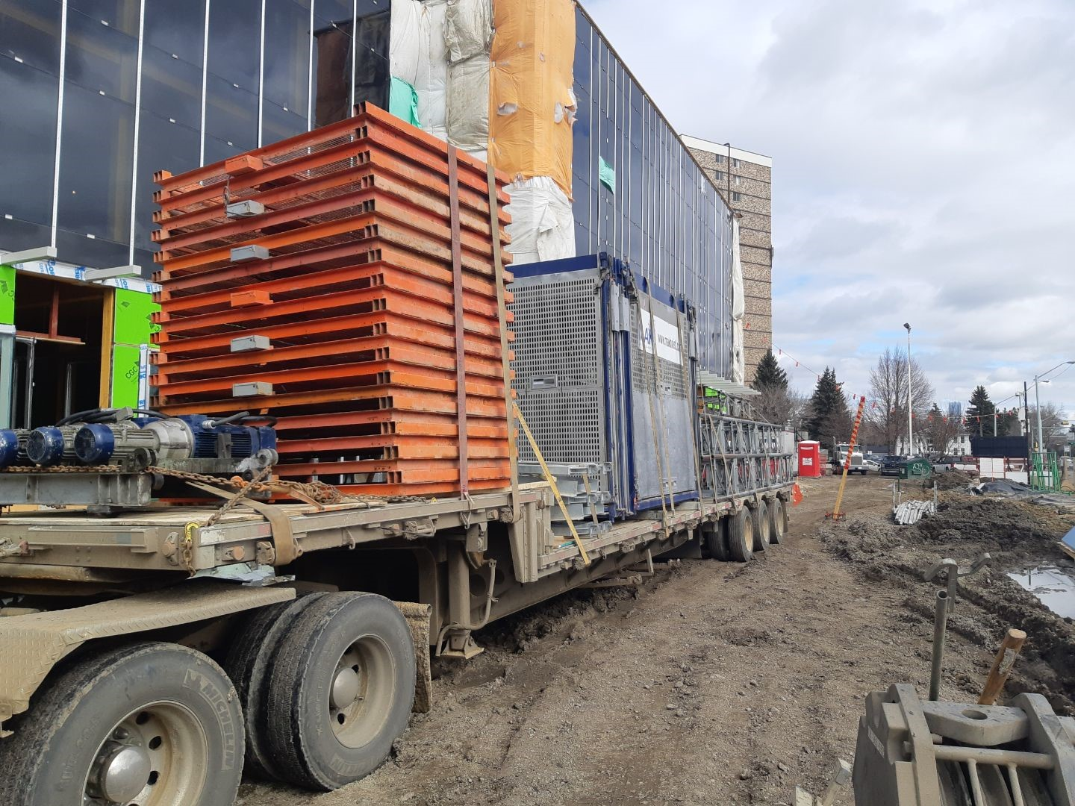
In the example shown, a variety of item were strapped using different methods.
The stack of orange metal required 1 more tie down at the front before being acceptable to transport. A winch was available.

Slide 79
